Slide 1
Moments of Inertia via Composite Parts and the Parallel Axis Theorem
Dr. Jacob Moore
Associate Professor of Mechanical Engineering
Penn State Mont Alto

Slide 2
Finding Moments of Inertia for Composite Areas or Bodies
As an alternative to the use of integration for finding area or mass moments of inertia, we can use lookup tables along with the parallel axis theorem to find a combined moment of inertia for a composite body.
In this way, we can skip the integration, instead using the work of others as a shortcut.
This is similar to the method we used to find the centroid or center of mass of a composite body.

Slide 3
Finding Moments of Inertia for Composite Bodies or Areas
The overall process is as follows
Break the composite shape/volume down into simple shapes/volumes that are in the lookup tables.
Look up the moments of inertia for each individual shape using the moment of inertia tables.
Use the parallel axis theorem to adjust moments of inertia to the common origin point.
Add the adjusted moments of inertia together to find the overall moment of inertia for the combined shape.

Slide 4
Method of Composite Parts
The first step in finding the combined moment of inertia, is to break our complex shape into simple shapes that are in our moment of inertia tables.
Holes or cutouts can be negative areas/masses
It is also useful to identify axes and an origin point at this point to use in calculations
1 .
2
1
3
2

Slide 5
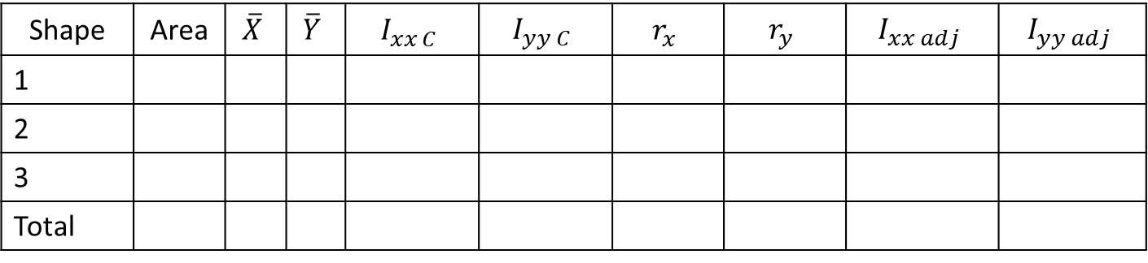
Method of Composite Parts
Next you are going to create a table to keep track of the various values.
Each row will be used for one part
The columns will vary from problem to problem, but generally follow the format below.
1 .
2
3
Shape | Area | $$\overline{X}$$ | $$\overline{Y}$$ | $$I_{xx C}$$ | $$I_{yy C}$$ | $$r_{x}$$ | $$r_{y}$$ | $$I_{xx adj}$$ | $$I_{yy adj}$$
1
2
3
Total

Slide 6
Method of Composite Parts
After determining the area or mass of each piece, the next step is to find the centroid location of each piece as well the overall centroid location.
We will generally be taking the overall moment of inertia about this overall centroid location.
Even if you are given the overall centroid location, we will still need to know the centroid location for the individual pieces.

Slide 7
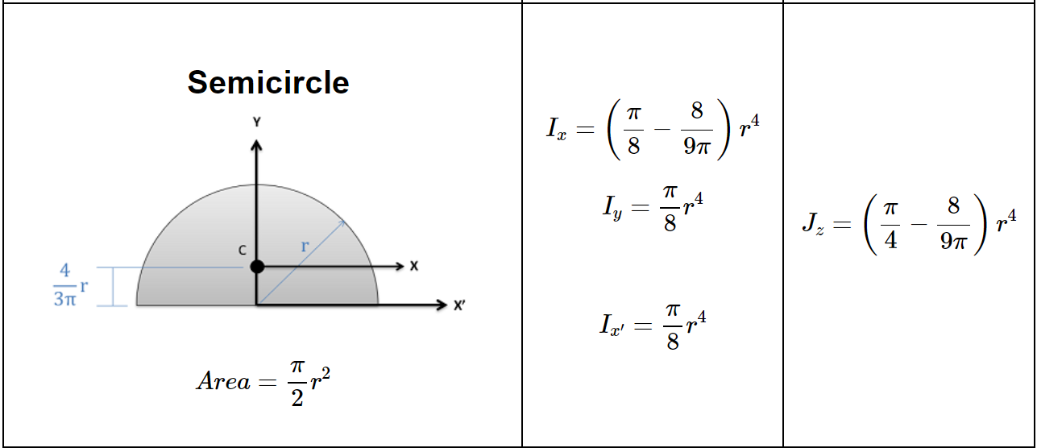
Method of Composite Parts
Next, you will look up and calculate the moments of inertia about their individual centroids.
Be sure to adjust the orientation to match the table to your situation .
1 .
2
Y
X
3

Slide 8
The Parallel Axis Theorem
We will eventually be adding together all the moments of inertia, but as of now we have a problem. Each shape has its moment of inertia given about different a point.
If we were to calculate the moment of inertia about a different point, we would get a different value
If all of the moments of inertia are taken about the same point, generally the combined centroid or center of mass, then we can add them together.

Slide 9

The Parallel Axis Theorem
The parallel axis theorem states that...
$$I_{xxP}=I_{xxC}+Ar^{2}$$
or...
$$I_{xxP}=I_{xxC}+mr^{2}$$
Area Moment About Any Point P
Distance between the two x axes
Area Moment About Centroid
Area of Shape
Mass Moment About Any Point P
Distance between the two x axes
Mass Moment About Centroid
Mass of Part

Slide 10







The Parallel Axis Theorem
The r value represents the distance you need to move the axis to “adjust” it to the new centroid or center of mass.
We are going to use the earlier centroid values in the table to find this adjustment distance “r”
$$Y_{c}$$
$$Y_{1}$$
$$Y_{2}$$
$$Y_{3}$$
$$r_{1}$$
$$r_{2}$$
$$r_{3}$$
1 .
2
3

Slide 11



The Parallel Axis Theorem
It’s important to determine how far the axis has moved, not necessarily how far the centroid has moved.
Regardless of direction, we can count the distance as positive.
y
$$r_{y}$$
C
x
$$r_{z}$$
y
$$r_{x}$$
P
x

Slide 12


Method of Composite Parts
Once you have figured out your r values, you will use those to find the adjusted moments of inertia for each piece.
Finally, the adjusted moments of inertia can be added up find the overall moment of inertia.
$$I_{xx adj}=I_{xxC}+Ar_{x}^{2}$$
$$I_{yy adj}=I_{yyC}+Ar_{y}^{2}$$
Shape | Area | $$\overline{X}$$ | $$\overline{Y}$$ | $$I_{xx C}$$ | $$I_{yy C}$$ | $$r_{x}$$ | $$r_{y}$$ | $$I_{xx adj}$$ | $$I_{yy adj}$$
1
2
3
Total

Slide 13
Thanks for Watching
See other engineering mechanics videos and access the full tool at…

Slide 14
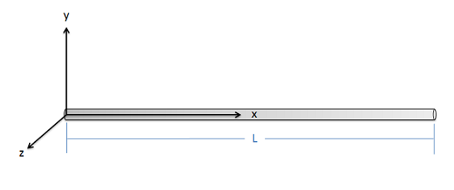
Parallel Axis Theorem Worked Example
Use the parallel axis theorem to find the mass moment of inertia of this slender rod with mass m and length L about the z axis at its end point.

Slide 15
Area Moment of Inertia Worked Example
A beam is made by connecting two 2 in by 4 in beams in a T pattern with the cross section as shown below. Determine the location of the centroid of this combined cross section and then find the rectangular area moment of inertia about the x axis through the centroid point.
4 in
2 in
4 in
2 in

Slide 16
Mass Moment of Inertia Worked Example
A dumbbell consists of two .2 meter diameter spheres, each with a mass of 40 kg. The spheres are attached to the ends of a .6 meter long, 20 kg slender rod. Determine the mass moment of inertia of the dumbbell about the y axis shown in the diagram.
y
.2 m
.3 m
.3 m
.2 m
40 kg
40 kg
20 kg

Slide 17
Mass Moment of Inertia Worked Example
A semicircular thin plate has constant density, a radius of 10 cm, and a mass of 400 g. Find the mass moment of inertia of the plate around the axes (a) x and (b) z passing through the centre of mass.

Slide 18




$$y$$
$$y$$
$$z$$
$$x$$
G
G
SIDE VIEW
FRONT VIEW

Slide 19
Mass Moment of Inertia Worked Example
A semicircular thin plate has constant density, a radius of 10 cm, and a mass of 400 g. Find the mass moment of inertia of the plate around the axes (a) x and (b) z passing through the centre of mass.

Slide 20
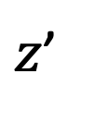

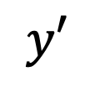



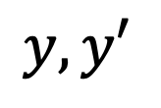
$$y$$
$$y, y′$$
$$y′$$
$$z$$
$$x$$
G
G
$z$’
$$x′$$
A
A
SIDE VIEW
FRONT VIEW

